Slide 1

User Review Sentiment Analysis
Zoey

Slide 2
Agenda
Inspiration
Process
Results
Challenges
Future Goal

Slide 3

Who Am I?
Mechanical Engineering
Biomedical Engineering
Medical Device Regulatory Affairs

Slide 4
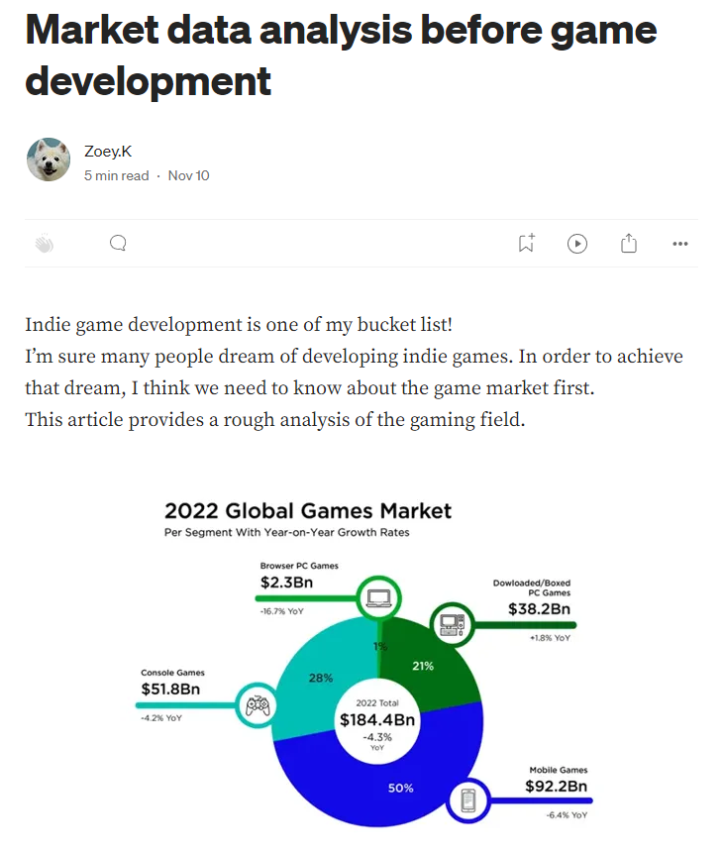
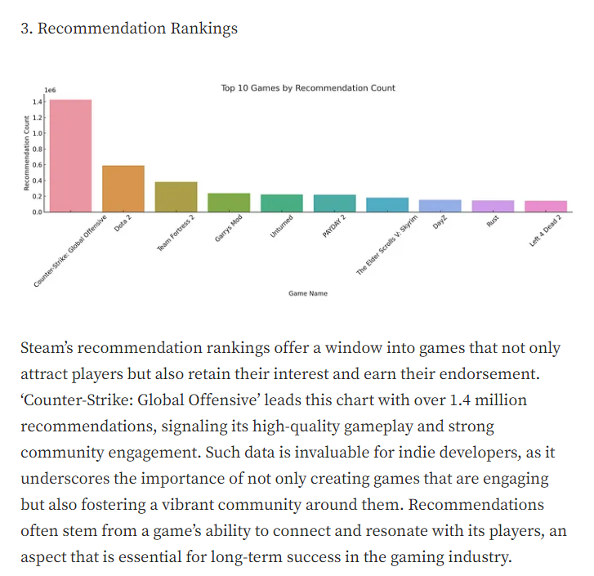


Analysis

Slide 5





Data Analysis Process
Step 1 Data Preprocessing
- NLTK for text processing.
- tokenizes (splits text into words)
- Remove non-English and convert all to lowercase
Step 2 Feature Extraction
- TF-IDF Vectorization
- Term Frequency-Inverse Document Frequency
Step 3 Model Training
- Data Splitting
- Random Forest Classifier (Uses 100 trees)
Step 4 Model Evaluation
- Evaluate the model's performance (accuracy, precision etc.)
Step 5 Visualization
- Visualize keywords and favorability for the resulting data set using Python and Tableau.
- Visualize by calculating correlation between reviews and other factors (price, etc.)

Slide 6










Favorability of Top 3 Reviews
97%
93%
86%
87%
62%
75%
My model
Recommendation
on the site
My model
Recommendation
on the site
My model
Recommendation
on the site

Slide 7
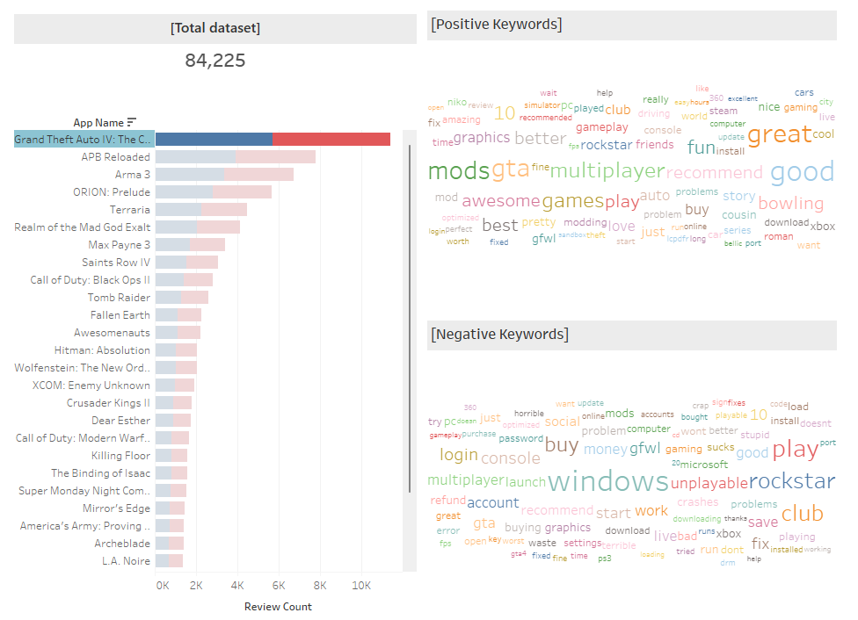
Keywords By Game

Slide 8
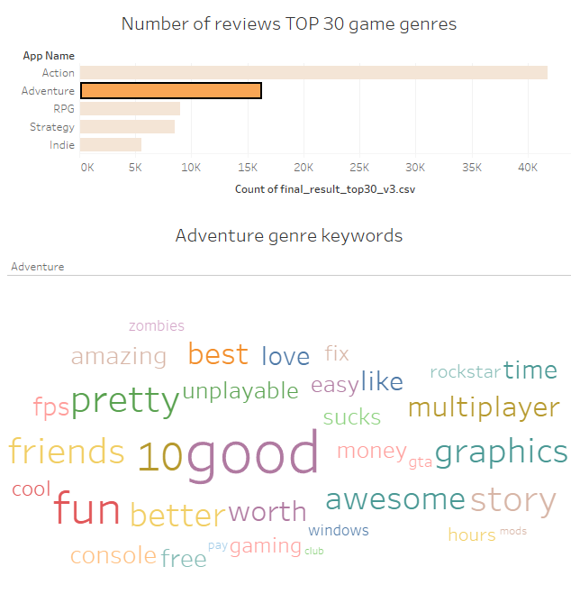
Keywords By genre

Slide 9


Challenges
Lack of time to analyze data
Various Emotions

Slide 10



Future Goal
Model with higher accuracy
More data analysis
Application to other fields

Slide 11
THANK YOU

